Slide 1
Облачна услуга Google Cloud Platform
(Google Cloud Platform)

Slide 2
История
Launched April 7, 2008
In April 2008, Google announced App Engine, a platform for developing and hosting web applications in Google-managed data centers, which was the first cloud computing service from the company. The service became generally available in November 2011. Since the announcement of App Engine, Google added multiple cloud services to the platform.

Slide 3
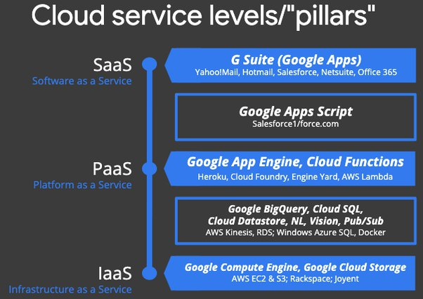
Типове облачни услуги в GCP

Slide 4
GCP concepts
Concept Name | Description
Google Cloud resources | Google Cloud consists of a set of physical assets, such as computers and hard disk drives, and virtual resources, such as virtual machines (VMs), that are contained in Google's data centers around the globe. Each data center location is in a region. Regions are available in Asia, Australia, Europe, North America, and South America. Each region is a collection of zones, which are isolated from each other within the region. Each zone is identified by a name that combines a letter identifier with the name of the region. For example, zone a in the East Asia region is named asia-east1-a.
Accessing resources through services | In cloud computing, what you might be used to thinking of as software and hardware products, become services. These services provide access to the underlying resources. The list of available Google Cloud services is long, and it keeps growing. When you develop your website or application on Google Cloud, you mix and match these services into combinations that provide the infrastructure you need, and then add your code to enable the scenarios you want to build.

Slide 5
Concepts (Cont.)
Global, regional, and zonal resources | Some resources can be accessed by any other resource, across regions and zones. These global resources include preconfigured disk images, disk snapshots, and networks. Some resources can be accessed only by resources that are located in the same region. These regional resources include static external IP addresses. Other resources can be accessed only by resources that are located in the same zone. These zonal resources include VM instances, their types, and disks.
Projects | Any Google Cloud resources that you allocate and use must belong to a project. You can think of a project as the organizing entity for what you're building. A project is made up of the settings, permissions, and other metadata that describe your applications. Resources within a single project can work together easily, for example by communicating through an internal network, subject to the regions-and-zones rules. A project can't access another project's resources unless you use Shared VPC or VPC Network Peering.

Slide 6
Concepts (end)
Ways to interact with the services | Google Cloud Console Command-line interface Client libraries
Client libraries | Google Cloud provides client libraries that enable you to easily create and manage resources. Google Cloud client libraries expose APIs for two main purposes: App APIs provide access to services. App APIs are optimized for supported languages, such as Node.js and Python. The libraries are designed around service metaphors, so you can work with the services more naturally and write less boilerplate code. The libraries also provide helpers for authentication and authorization. Admin APIs offer functionality for resource management. For example, you can use admin APIs if you want to build your own automated tools. You also can use the Google API client libraries to access APIs for products such as Maps, Drive, and YouTube.

Slide 7
Regions and zones
Regions are independent geographic areas that consist of zones. Zones and regions are logical abstractions of underlying physical resources provided in one or more physical data centers. These data centers may be owned by Google and listed on the Google Cloud locations page, or they may be leased from third-party data center providers.
A zone is a deployment area for Google Cloud resources within a region. Zones should be considered a single failure domain within a region. To deploy fault-tolerant applications with high availability and help protect against unexpected failures, deploy your applications across multiple zones in a region.

Slide 8
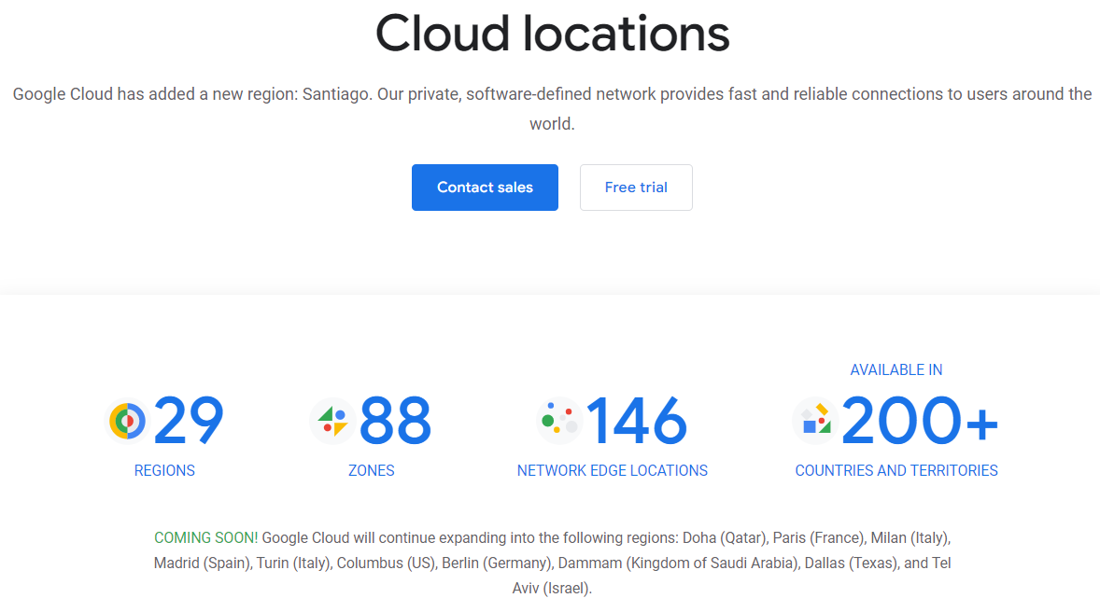
Cloud locations (17.04.2022)

Slide 9
Resources Types
Zonal resources - operate within a single zone. Zonal outages can affect some or all of the resources in that zone. An example of a zonal resource is a Compute Engine virtual machine (VM) instance that resides within a specific zone.
Regional resources - resources that are redundantly deployed across multiple zones within a region, for example App Engine applications, or regional managed instance groups. This gives them higher availability relative to zonal resources.
Multiregional resources - Multiple Google Cloud services are managed by Google to be redundant and distributed within and across regions. These services optimize availability, performance, and resource efficiency. As a result, these services require a trade-off between either latency or the consistency model. These trade-offs are documented on a product specific basis.

Slide 10
Points of presence (POPs)
Google operates a global network of peering points of presence, which means that customer traffic can travel within the Google network until it's close to its destination, providing users with a better experience and better security.
Geographic management of data - Google understands that each customer might have unique security and compliance needs. When using regional or zonal storage resources, we strongly recommend that you replicate data to another region or snapshot it to a multiregional storage resource for disaster recovery purposes.

Slide 11
Application deployment considerations
To build highly available services and applications that can withstand zones becoming unavailable, use the following:
Regional resources, such as App Engine applications, regional managed instance groups, or managed multiregional resources such as Cloud Storage, Datastore, Firestore, or Spanner.
Zonal resources, such as Compute Engine virtual machines, but manage your own compute and storage redundancy across zones or across regions. Edge Zones are small-footprint extensions of Azure placed in population centers that are far from Azure regions. Azure public MEC (multi-access edge compute) integrates Azure compute and services with mobile operator 5G connectivity for low-latency applications at the operator edge.

Slide 12
For compute, use the following strategy:
Use zonal or regional resources, such as Compute Engine or App Engine, but manually or automatically bring up your application in another region (on regional failure) referring to copies of your primary data if the data is not already in a managed, multiregional resource.

Slide 13
Billing
A Cloud Billing account defines who pays for a given set of Google Cloud resources. To use Google Cloud services, you must have a valid Cloud Billing account, and must link it to your Google Cloud projects. Your project's Google Cloud usage is charged to the linked Cloud Billing account.
You must have a valid Cloud Billing account even if you are in your free trial period or if you only use Google Cloud resources that are covered by the Google Cloud Free Tier.
You also need a Cloud Billing account to pay for your use of the Google Maps Platform APIs

Slide 14
Google Cloud Free Program
90-day, $300 Free Trial: New Google Cloud and Google Maps Platform users can take advantage of a 90-day trial period that includes $300 in free Cloud Billing credits to explore and evaluate Google Cloud and Google Maps Platform products and services. You can use these credits toward one or a combination of products.
Free Tier: All Google Cloud customers can use select Google Cloud products—like Compute Engine, Cloud Storage, and BigQuery—free of charge, within specified monthly usage limits. When you stay within the Free Tier limits, these resources are not charged against your Free Trial credits or to your Cloud Billing account's payment method after your trial ends.

Slide 15
Free Trial 90-day, $300
You've never been a paying customer of Google Cloud, Google Maps Platform, or Firebase.
You haven't previously signed up for the Free Trial.
You can't add GPUs to your VM instances.
You can't request a quota increase. For an overview of Compute Engine quotas, see Resource quotas.
You can't create VM instances that are based on Windows Server images.
You can't create Google Cloud VMware Engine resources.

Slide 16
Free Tier
The Free Tier provides limited access to many common Google Cloud products and services free of charge. Unlike the Free Trial, the Free Tier is available to all Google Cloud users.
Free Tier resources are provided at intervals, usually monthly. Free Tier resources are not credits; they don't accumulate or roll over from one interval to the next.
Any usage above Free Tier usage limits is automatically billed at standard rates.

Slide 17
GCP Regions
North America
South America
Europe
Middle East
Asia Pacific
Oceania
Africa

Slide 18
GCP in Europe (17.04.2022)
Amsterdam, Netherlands (5)
Budapest, Hungary
Bucharest, Romania
Dublin, Ireland (2)
Frankfurt, Germany (2)
Hamburg, Germany (3)
Kiev, Ukraine (3)
Lisbon, Portugal
London, UK (7)
Madrid, Spain (2)
Marseille, France
Milan, Italy (2)
Munich, Germany
Moscow, Russia (3)
Paris, France (8)
Prague, Czech Republic
Rome, Italy
Saint Petersburg, Russia (2)
Sofia, Bulgaria
Stockholm, Sweden (3)
Warsaw, Poland (2)
Zagreb, Croatia
Zürich, Switzerland (4)

Slide 19
Google Data Centers
Google owns and operates data centers all over the world, helping to keep the internet humming 24/7. Learn how our relentless focus on innovation has made our data centers some of the most high-performing, secure, reliable, and efficient data centers in the world.
2007: We became the first major company to be carbon neutral for our operations.
2017: We became the first major company to match 100% of our annual electricity use with renewable energy, which we’ve achieved for four consecutive years.
2020: We issued $5.75 billion in sustainability bonds—the largest sustainability or green bond issuance by any company in history.
2020: We compensated for our legacy carbon footprint, making Google the first major company to be carbon neutral for its entire operating history

Slide 20
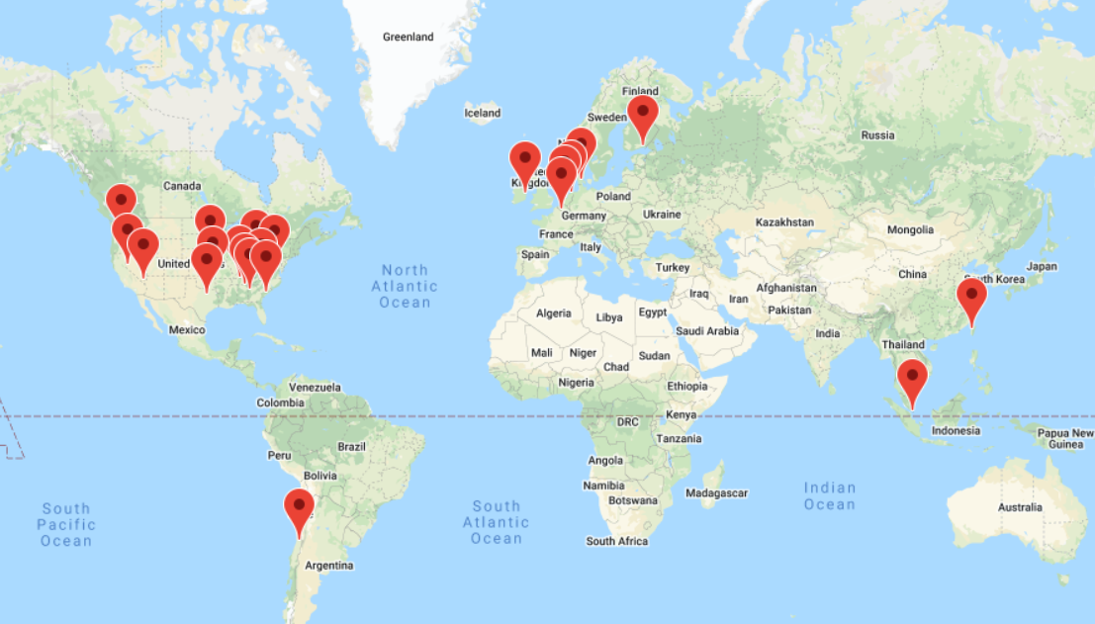
Locations

Slide 21
Networks
14 Subsea cables
146 network edge locations and CDN to deliver the content. This is the same network that also powers Google Search, Maps, Gmail, and YouTube.
100s of 1000s of miles of fiber optic cable
Google network infrastructure consists of three main types of networks:
Data center network, which connects all the machines in the network together.
Software-based private network WAN connects all data centers together
Software defined public WAN for user-facing traffic entering the Google network

Slide 22
Categories
AI and Machine Learning
API Management
Compute
Containers
Data Analytics
Databases
Developer Tools
Healthcare and Life Sciences tools
Hybrid and Multicloud
Internet of Things (IoT)
Management Tools
Media and Gaming
Migration
Networking
Operations
Security and Identity
Serverless Computing
Storage

Slide 23
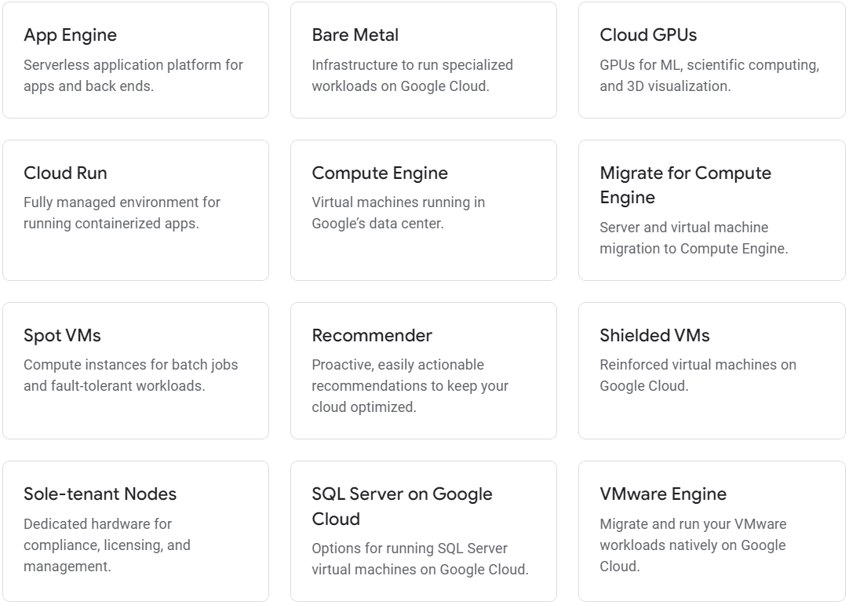
Compute

Slide 24
App Engine
Build monolithic server-side rendered websites and stay agile. App Engine supports popular development languages and offers a range of developer tools.
Popular programming languages - Build your application in Node.js, Java, Ruby, C#, Go, Python, or PHP.
Fully managed - A fully managed environment lets you focus on code while App Engine manages infrastructure concerns.

Slide 25
App Engine environments
Standard environment. Application instances run in a sandbox, using the runtime environment of a supported language listed below. Applications that need to deal with rapid scaling.
Flexible environment. Application instances run within Docker containers on Compute Engine virtual machines (VM). Applications that receive consistent traffic, experience regular traffic fluctuations, or meet the parameters for scaling up and down gradually.

Slide 26
Standard environment
Source code is written in specific versions of the supported programming languages:
Python 2.7, Python 3.7, Python 3.8, Python 3.9
Java 8, Java 11, and Java 17 (preview)
Node.js 10, Node.js 12, Node.js 14, Node.js 16
PHP 5.5, PHP 7.2, PHP 7.3, and PHP 7.4
Ruby 2.5, Ruby 2.6, Ruby 2.7, and Ruby 3.0 (preview)
Go 1.11, Go 1.12, Go 1.13, Go 1.14, Go 1.15, and Go 1.16
Intended to run for free or at very low cost, where you pay only for what you need and when you need it. For example, your application can scale to 0 instances when there is no traffic.
Experiences sudden and extreme spikes of traffic which require immediate scaling.

Slide 27
Flexible environment
Source code that is written in a version of any of the supported programming languages: Python, Java, Node.js, Go, Ruby, PHP, or .NET
Runs in a Docker container that includes a custom runtime or source code written in other programming languages.
Uses or depends on frameworks that include native code.
Accesses the resources or services of your Google Cloud project that reside in the Compute Engine network.

Slide 28
Comparizon
Feature | Standard environment | Flexible environment
Instance startup | Seconds | Minutes
Maximum request timeout | Depends on the runtime and type of scaling. | 60 minutes
Background threads | Yes, with restrictions | Yes
Background processes | No | Yes
Scaling | Manual, Basic, Automatic | Manual, Automatic
Scale to zero | Yes | No, minimum 1 instance
Modifying the runtime | No | Yes (through Dockerfile)
Deployment time | Seconds | Minutes
Automatic in-place security patches | Yes | Yes (excludes container image runtime)
Location | North America, Asia Pacific, or Europe | North America, Asia Pacific, or Europe
Pricing | Based on instance hours | Based on usage of vCPU, memory, and persistent disks

Slide 29
Bare Metal Solution for Oracle
State-of-the-art certified infrastructure, precision tuned to meet all your performance needs
Deploy Oracle capabilities like clustered databases, replication, and all performance features
Seamlessly take advantage of all Google Cloud services with less than 2 ms latency
Leverage your on-premises licensing, run books, database administrators, and system integrators
Billing, support, and SLA provided by Google Cloud

Slide 30
Cloud GPUs
High-performance GPUs on Google Cloud for machine learning, scientific computing, and 3D visualization.
Speed up compute jobs like machine learning and HPC
A wide selection of GPUs to match a range of performance and price points
Flexible pricing and machine customizations to optimize for your workload
A range of GPU types - NVIDIA K80, P100, P4, T4, V100, and A100 GPUs provide a range of compute options to cover your workload for each cost and performance need.
Flexible performance - Optimally balance the processor, memory, high performance disk, and up to 8 GPUs per instance for your individual workload. All with the per-second billing.

Slide 31
Cloud Run
Develop and deploy highly scalable containerized applications using your favorite language or framework (Go, Python, Java, Node.js, .NET, and more) on a fully managed serverless platform.
All Google Cloud customers get 2 million requests per month completely free of charge.
Any language, any library, any binary - Use the programming language of your choice, any language or operating system libraries, or even bring your own binaries.
Cloud Run pairs great with the container ecosystem: Cloud Build, Cloud Code, Artifact Registry, and Docker.
Only pay when your code is running, billed to the nearest 100 milliseconds.

Slide 32
Compute Engine
Secure and customizable compute service that lets you create and run virtual machines on Google’s infrastructure.
New customers get $300 in free credits to spend on Google Cloud. All customers get a general purpose machine (e2-micro instance) per month for free, not charged against your credits.
Predefined machine types: Start running quickly with pre-built and ready-to-go configurations
Custom machine types: Create VMs with optimal amounts of vCPU and memory, while balancing cost
Spot machines: Reduce computing costs by up to 91%.
Confidential computing: Encrypt your most sensitive data while it’s being processed
Rightsizing recommendations: Optimize resource utilization with automatic recommendations

Slide 33
Virtual machine types
Scale-out workloads (T2D) T2D offers the best price-performance compared to general-purpose VMs from any of the leading public cloud vendors. It is the first instance type in the Tau VM family and comes in predefined shapes, with up to 60vCPUs per VM and 4GB of memory per vCPU. T2D is ideal for scale-out workloads like web servers, containerized microservices, media transcoding, and large scale java applications.
General purpose workloads (E2, N2, N2D, N1) E2, N2, N2D, and N1 are general-purpose machines offering a good balance of price and performance, and are suitable for a wide variety of common workloads including databases, development and testing environments, web applications, and mobile gaming. They support up to 224 vCPUs and 896 GB of memory.
Ultra-high memory (M2, M1) Memory-optimized machines offer the highest memory configurations with up to 12 TB for a single instance. They are well suited to memory-intensive workloads such as large in-memory databases like SAP HANA, and in-memory data analytics workloads.

Slide 34
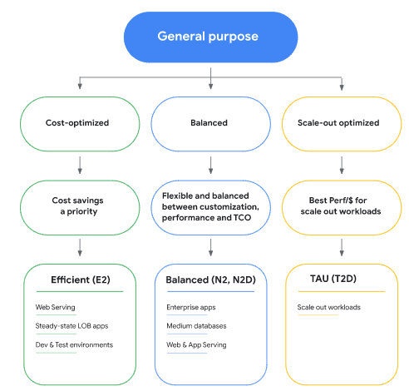

Slide 35
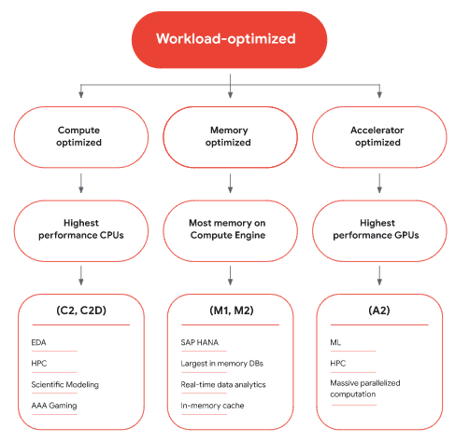

Slide 36
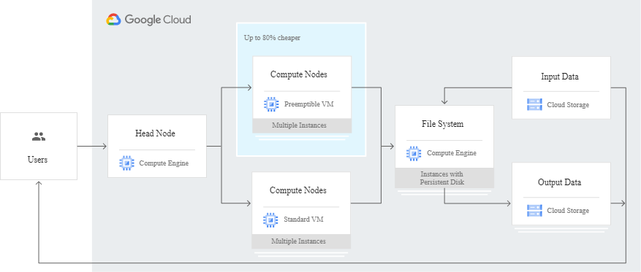
Typical application

Slide 37
Other features
VM Manager | VM Manager is a suite of tools that can be used to manage operating systems for large virtual machine (VM) fleets running Windows and Linux on Compute Engine.
Confidential VMs | Confidential VMs are a breakthrough technology that allows you to encrypt data in use—while it’s being processed. It is a simple, easy-to-use deployment that doesn't compromise on performance. You can collaborate with anyone, all while preserving the confidentiality of your data.
Live migration for VMs | Compute Engine virtual machines can live-migrate between host systems without rebooting, which keeps your applications running even when host systems require maintenance.
Spot VMs | Affordable compute instances suitable for batch jobs and fault-tolerant workloads. Spot VMs provide significant savings of up to 91%, while still getting the same performance and capabilities as regular VMs.

Slide 38
Instance groups | An instance group is a collection of virtual machines running a single application. It automatically creates and deletes virtual machines to meet the demand, repairs workload from failures, and runs updates.
Per-second billing | Google bills in second-level increments. You pay only for the compute time that you use.
Commitment savings | With committed-use discounts, you can save up to 57% with no up-front costs or instance-type lock-in.
Container support | Run, manage, and orchestrate Docker containers on Compute Engine VMs with Google Kubernetes Engine.
Reservations | Create reservations for VM instances in a specific zone. Use reservations to ensure that your project has resources for future increases in demand. When you no longer need a reservation, delete the reservation to stop incurring charges for it.

Slide 39
Migrate for Compute Engine
Whether you’re looking to migrate one application from on-premises or one thousand enterprise-grade applications across multiple data centers, Migrate for Compute Engine gives any IT team, large or small, the power to migrate their workloads to Google Cloud.
With Migrate for Compute Engine’s simple “as a service” interface within Cloud Console and flexible migration options, it’s easy for anyone to reduce the time and toil that typically goes into a migration. Avoid complex deployments, setup, and configurations. Eliminate confusing and troublesome client-side migration tool agents. By using the right migration tool, you can save your migration team’s valuable time for what matters most: migrating workloads.

Slide 40
Spot VMs
Spot VMs are highly affordable compute instances suitable for batch jobs and fault-tolerant workloads. Spot VMs offer the same machine types, options, and performance as regular compute instances. If your applications are fault tolerant and can withstand possible instance preemptions, then Spot instances can reduce your Compute Engine costs by up to 91%! ( at least a 60% off guarantee.)
Supplement your regular VMs with lower-cost Spot instances to finish your compute-intensive work faster, saving you time and money. Throw Spot VMs at fault-tolerant workloads such as high performance computing, big data and analytics, continuous integration/continuous delivery (CI/CD), rendering/transcoding, and testing.

Slide 41
Shielded VMs
Shielded VMs are virtual machines (VMs) on Google Cloud hardened by a set of security controls that help defend against rootkits and bootkits. Using Shielded VMs helps protect enterprise workloads from threats like remote attacks, privilege escalation, and malicious insiders. Shielded VMs leverage advanced platform security capabilities such as secure and measured boot, a virtual trusted platform module (vTPM), UEFI firmware, and integrity monitoring.

Slide 42
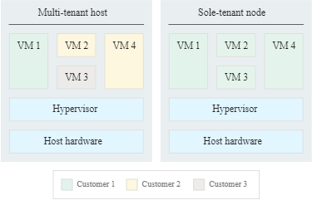
Sole-tenant nodes
Sole-tenancy lets you have exclusive access to a sole-tenant node, which is a physical Compute Engine server that is dedicated to hosting only your project's VMs.

Slide 43
SQL Server on Google Cloud
Migrate and run Microsoft SQL Server on Compute Engine or use managed Cloud SQL for SQL Server
Bring your existing SQL Server licenses and run them on Compute Engine
Run license-included SQL Server VM images on Compute Engine
Use fully managed Cloud SQL for SQL Server to reduce operational overhead
Full compatibility and configurable custom VM shapes help you optimize cost

Slide 44
Google Cloud VMware Engine
Easily lift and shift your VMware-based applications to Google Cloud without changes to your apps, tools, or processes. Includes all the hardware and VMware licenses to run in a dedicated VMware SDDC in Google Cloud.
VMware Engine is built on Google Cloud’s highly performant, scalable infrastructure with fully redundant and dedicated 100 Gbps networking, providing 99.99% availability to meet the needs of your most demanding enterprise workloads.

Slide 45
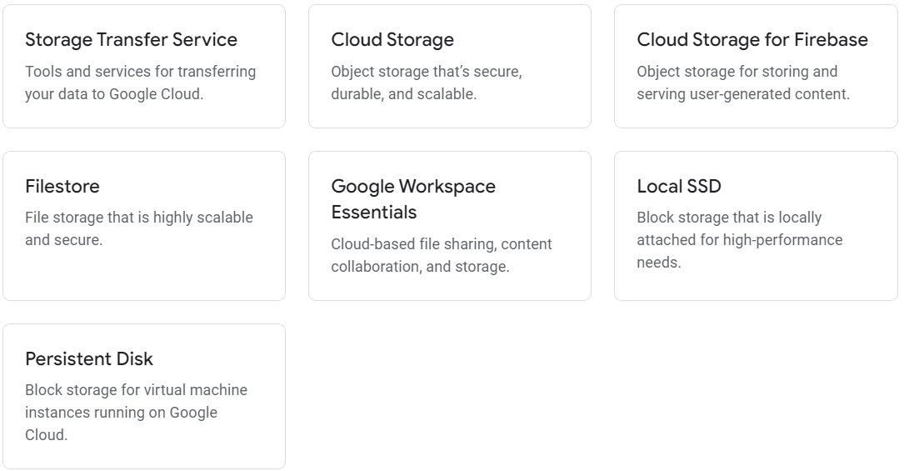
Storage

Slide 46
Storage Transfer Service
Secure, low-cost services for transferring data from cloud or on-premises sources.
Complete transfers without writing a single line of code
Centralized job management to monitor transfer status
Security and reliability built in, every step of the way
Configure your data transfer to meet your business needs: manage cost, time, and schedule

Slide 47
Explore common use cases for Storage Transfer Service
Data center migration
Content storage and delivery
Disaster recovery, backup, and archival
Analytics and machine learning
PRODUCT | PRICING
Storage Transfer Service | Free
Storage Transfer Service for on-premises data | $0.0125/GB

Slide 48
Cloud Storage
Reliable and secure object storage
multiple automatic redundancy options
Object storage for companies of all sizes. Store any amount of data. Retrieve it as often as you’d like.
Deploy new storage capacity 99% faster than with on-premises environments.
Replicate 100% of your data between regions in 15 mins or less.
Understand what it means to have 99.999999999% annual storage durability.

Slide 49
Storage classes for any workload
Save costs without sacrificing performance by storing data across different storage classes. You can start with a class that matches your current use, then reconfigure for cost savings.
Standard Storage: Good for “hot” data that’s accessed frequently, including websites, streaming videos, and mobile apps.
Nearline Storage: Low cost. Good for data that can be stored for at least 30 days, including data backup and long-tail multimedia content.
Coldline Storage: Very low cost. Good for data that can be stored for at least 90 days, including disaster recovery.
Archive Storage: Lowest cost. Good for data that can be stored for at least 365 days, including regulatory archives.

Slide 50
Filestore
High-performance, fully managed file storage.
Scales to meet needs of high performance workloads - For workloads that are latency sensitive, like high performance computing, data analytics, or other metadata intensive applications, Filestore supports capacity up to 100 TB and throughput of 25 GB/s and 920K IOPS.
99.99% regional availability SLA - built for critical applications (e.g., SAP) requiring regional availability to ensure the applications are unphased in a zonal outage.
Protect your data with backups and snapshots - Filestore offers instantaneous backups and snapshots to help you protect your data easily. Back up data and metadata of the file share, set up a regular backup schedule, or take snapshots of your instances anytime you need. Recovering some or all of your data from a prior snapshot recovery point in 10 minutes or less.

Slide 51
Filestore Use cases
Enterprise application migrations (SAP). Many on-premises applications require a file system interface. We've made it easy to migrate your enterprise applications to the cloud with our fully managed storage service. Filestore Enterprise is built for critical applications requiring regional availability and having unstructured NFS data requirements.
Financial services and technology - Quantitative researchers and modelers require ready access to powerful compute and storage resources to deliver useful, time-to-value trading insights. Filestore High Scale is built for high performance computing (HPC) applications to access, sort, process, model, and deliver the right information to the right decision-maker at the right time.

Slide 52
Filestore Use cases (Cont.)
Web content management - Web developers and large hosting providers rely on Filestore to manage and serve web content, including needs such as WordPress hosting.
Media rendering - You can easily mount Filestore file shares on Compute Engine instances, enabling visual effects artists to collaborate on the same file share. As rendering workflows typically run across fleets (“render farms”) of compute machines, all of which mount a shared filesystem, Filestore and Compute Engine can scale to meet your job’s rendering needs.
Data analytics - Compute complex financial models or analyze environmental data with Filestore. As capacity or performance needs change, easily grow or shrink your instances as needed. As a persistent and shareable storage layer, Filestore enables immediate access to data for high-performance, smart analytics.

Slide 53
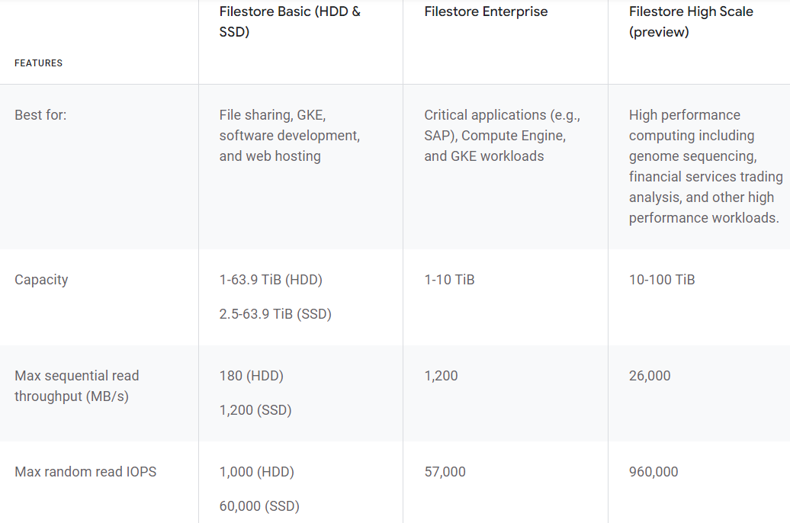
Filestore performance tiers:

Slide 54
Local SSD
High-performance, ephemeral storage
Local SSDs are physically attached to the server that hosts your VM instance. This tight coupling offers superior performance, very high input/output operations per second (IOPS), and very low latency compared to other block storage options. Local SSDs are designed for temporary storage use cases such as caches or scratch processing space. Which makes them suitable for workloads like media rendering, data analytics, or high-performance computing.

Slide 55
Persistent Disk
Reliable, high-performance block storage for virtual machine instances.
Industry-leading price and performance, including SSD and HDD
Attach to virtual machine instances running in Compute Engine or Google Kubernetes Engine
Transparently resize, quickly back up, and support simultaneous readers

Slide 56
Key features
Seamless backup and restore - For maximum flexibility and minimal effort, snapshots are geo-replicated and available for restore in all regions by default. Snapshots of a block device can take place in minutes rather than hours.
Automatic encryption - Persistent Disks are automatically encrypted to protect your data, in transit or at rest. You can supply your own key, or we will automatically generate one for you.
Independent volumes - Your storage is located independently from your virtual machine instances, so you can detach or move your disks to keep your data even after you delete your instances.

Slide 57
Features
Disk Clones | Use Disk Clones to quickly bring up staging environments from production, create new disks for backup verification or data export jobs, and create disks in a different project.
High durability | Persistent Disk is designed for high durability. It stores data redundantly to ensure data integrity.
Resizeable volumes | Persistent disk performance scales automatically with size, so you can resize your existing persistent disks or add more persistent disks to an instance to meet your performance and storage space requirements. Each persistent disk can be up to 64 TB in size, so there is no need to manage arrays of disks to create large logical volumes.
Independent volumes | Your storage is located independently from your virtual machine instances, so you can detach or move your disks to keep your data even after you delete your instances.
Snapshots | Create snapshots to periodically back up data from your zonal persistent disks or regional persistent disks. To reduce the risk of unexpected data loss, consider the best practice of setting up a snapshot schedule to ensure your data is backed up on a regular schedule.
Machine Images | Use a machine image to store all the configuration, metadata, permissions, and data from one or more disks for a VM instance running on Compute Engine. The VM instance that you use to create a machine image is referred to as a source instance.

Slide 58
Pricing
TYPE | PRICE (MONTHLY IN USD)
Standard provisioned space | $0.040 PER GB
SSD provisioned space | $0.170 PER GB
Balanced provisioned space | $0.100 PER GB
Extreme provisioned space | $0.125 PER GB
Extreme provisioned IOPS | $0.065 PER IOPS PROVISIONED
Regional standard provisioned space | $0.080 PER GB
Regional SSD provisioned space | $0.340 PER GB
Regional balanced provisioned space | $0.200 PER GB
Snapshot storage | $0.026 PER GB
Multi-regional snapshot storage | $0.026 PER GB

Slide 59
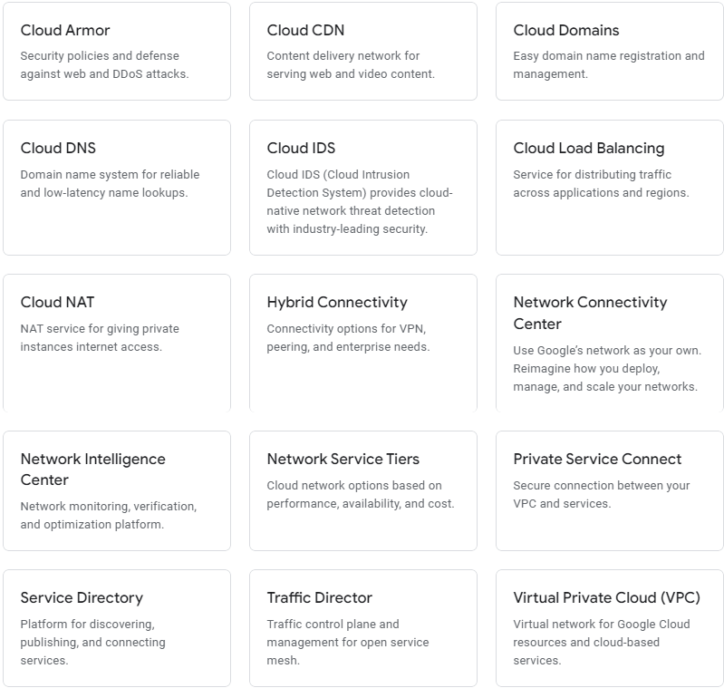
Networking

Slide 60
Google Cloud Armor
Help protect your applications and websites against denial of service and web attacks.
Benefit from DDoS protection and WAF at Google scale
Detect and mitigate attacks against your Cloud Load Balancing workloads
Adaptive Protection ML-based mechanism to help detect and block Layer 7 DDoS attacks
Mitigate OWASP Top 10 risks and help protect workloads on-premises or in the cloud
Bot management to stop fraud at the edge through native integration with reCAPTCHA Enterprise

Slide 61
Pre-defined WAF rules to mitigate OWASP Top 10 risks | Out-of-the-box rules based on industry standards to mitigate against common web-application vulnerabilities and help provide protection from the OWASP Top 10.
Rich rules language for web application firewall | Create custom rules using any combination of L3–L7 parameters and geolocation to help protect your deployment with a flexible rules language.
Visibility and monitoring | Easily monitor all of the metrics associated with your security policies in the Cloud Monitoring dashboard. You can also view suspicious application traffic patterns from Cloud Armor directly in the Security Command Center dashboard.
Logging | Get visibility into Cloud Armor decisions as well as the implicated policies and rules on a per-request basis via Cloud Logging.
Preview mode | Deploy Cloud Armor rules in preview mode to understand rule efficacy and impact on production traffic before enabling active enforcement.
Policy framework with rules | Configure one or more security policies with a hierarchy of rules. Apply a policy at varying levels of granularity to one or many workloads.
IP-based and geo-based access control | Filter your incoming traffic based on IPv4 and IPv6 addresses or CIDRs. Identify and enforce access control based on geographic location of incoming traffic.
Support for hybrid and multicloud deployments | Help defend applications from DDoS or web attacks and enforce Layer 7 security policies whether your application is deployed on Google Cloud or in a hybrid or multicloud architecture.
Named IP Lists | Allow or deny traffic through a Cloud Armor security policy based on a curated Named IP List.

Slide 62
Pricing
CLOUD ARMOR | STANDARD | MANAGED PROTECTION PLUS
Billing | Pay as you go | Starting at $3,000/month
Protected resources | None | Includes first 100 ($30/month for additional protected resources)
Rules | $1 / month | Included in subscription
Policy | $5 / month | Included in subscription
Requests | $0.75 / million queries | Included in subscription
Data processing fee | None | Additional (details)
Term | None | 1 year

Slide 63
Cloud CDN
Fast, reliable web and video content delivery with global scale and reach.
Provides privacy and data security
Origin and backend support. Pull content from any HTTP-capable origin, including Compute Engine, Cloud Storage and Google Kubernetes Engine backends and origins outside of Google Cloud, such as storage buckets in other clouds.
Caching. Configure caching behavior by origin that allows you to have fine-grained control over cache keys, TTLs, and other caching features based on the content type being served.
Route matching and origin selection. Cloud CDN uses Cloud Load Balancing to provide comprehensive routing and configuration capabilities at each edge location.

Slide 64
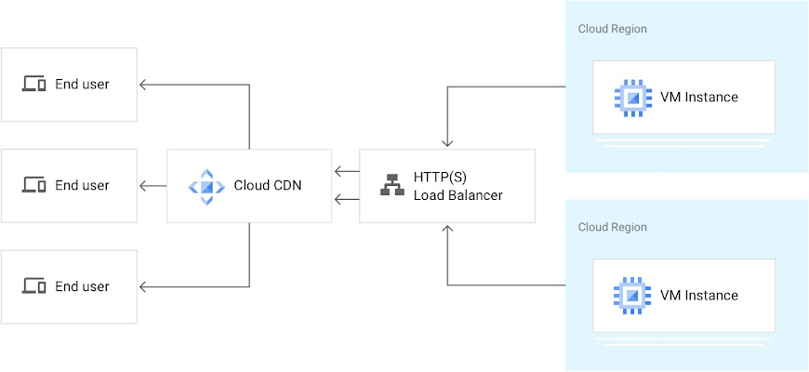
Using Cloud CDN with HTTP(S) load balancing
When Cloud CDN serves your content, you’re charged for bandwidth and HTTP/HTTPS requests. On cache hits, you pay for cache egress bandwidth. On cache misses, you additionally pay for cache fill bandwidth.

Slide 65
DNS Services
Cloud Domains. Register new domains, transfer existing domains, and manage domains within Google Cloud. Cloud Domains offers easy domain renewal through Cloud Billing, bulk management through the API, and permission management through IAM. Cloud Domains supports more than 300 domain endings with free privacy protection, automatic domain verification, and one-click DNSSEC enablement.
Cloud DNS. Reliable, resilient, low-latency DNS serving from Google's worldwide network with everything you need to register, manage, and serve your domains. Easily publish and manage millions of DNS zones and records using our simple user interface

Slide 66
Cloud IDS
Cloud IDS (Cloud Intrusion Detection System) provides cloud-native network threat detection with industry-leading security.
Detect network-based threats such as malware, spyware, command-and-control attacks
Get east-west and north-south traffic visibility to monitor intra- and inter-VPC communication
Benefit from a cloud-native, managed experience with high performance and simple deployment
Generate high-quality network-based threat data for threat investigation and correlation.
Cloud IDS is built with Palo Alto Networks’ industry-leading threat detection capabilities
Cloud IDS billing is based on two metrics:
(1) A per-hour charge for each Cloud IDS endpoint created and running
(2) A per-GB charge based on the total amount of traffic inspected

Slide 67
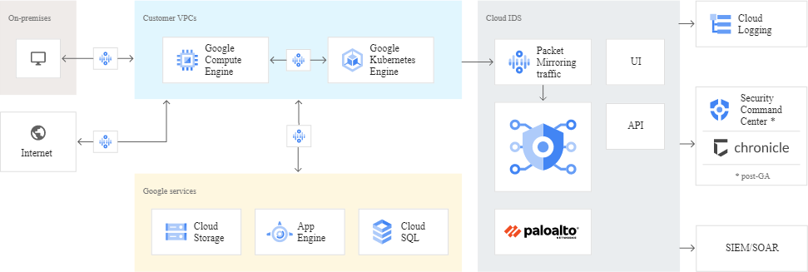
Cloud IDS example

Slide 68
Cloud Load Balancing
High performance, scalable load balancing on GCP
Cloud Load Balancing can put your resources behind a single anycast IP and scale your resources up or down with intelligent autoscaling. Cloud Load Balancing comes in a variety of flavors and is integrated with Cloud CDN for optimal application and content delivery.
Global load balancing with single anycast IP
Supports 1 million+ queries per second with consistent high performance and low latency.
Cloud Load Balancing can scale as your users and traffic grow, including easily handling huge, unexpected, and instantaneous spikes by diverting traffic to other regions in the world that can take traffic. Autoscaling does not require pre-warming: you can scale from zero to full throttle in a matter of seconds.

Slide 69
Connection options
Dedicated Interconnect - Connect up to 2x 100G transport circuits for private cloud traffic to Google Cloud at any of our POPs.
Partner Interconnect can also deliver something else: direct access to Google services—including Cloud Storage and BigQuery—through Private Google Access for on-premises.
For low-volume data connections, Cloud VPN offers a lower cost option that delivers 1.5–3.0 Gbps over an encrypted public internet connection. Cloud VPN's flexible routing options allow you to use static or dynamic routing to connect to different VPN gateways.
Direct and carrier peering - provides a direct path from your on-premises network to Google services, including Google Cloud products that can be exposed through one or more public IP addresses. Carrier Peering enables you to access Google applications, such as Google Workspace, by using a service provider to obtain enterprise-grade network services that connect your infrastructure to Google.

Slide 70
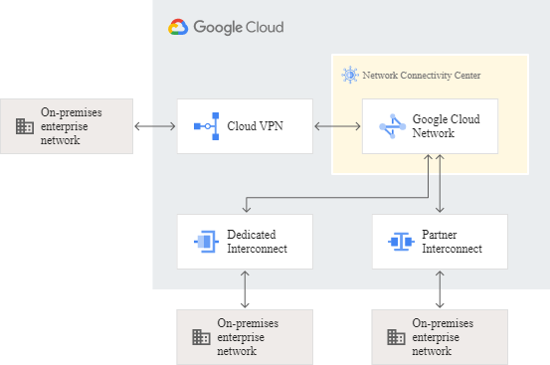
Network Connectivity Center
Network Connectivity Center offers the unique ability to easily connect your on-premises, Google Cloud, and other cloud enterprise networks and manage them as spokes through a single, centralized logical hub on Google Cloud.

Slide 71
Private Service Connect
Creates a private and secure connection from your VPCs to Google, third parties, or your own services.
Keep traffic between your VPC and services within the Google network
Line rate performance and scales to enterprise-size networks
Use in conjunction with Service Directory for service-centric networking

Slide 72
Features
Access Google APIs and services | Connect to Google Cloud services like Cloud Storage and Cloud Bigtable using Private Service Connect endpoints with internal IP addresses in your VPC networks.
Connect to a service in another VPC network | Connect to your own services or those provided by other service producers (ex. MongoDB, Snowflake) using a Private Service Connect endpoint.
Publish services as a service producer | You can publish a service (make a service available outside your VPC network) by using an internal TCP/UDP load balancer and create a service attachment in the same region.
Service Directory | Private Service Connect endpoints are registered with Service Directory for Google APIs where you can store, manage, and publish services.
Proxy protocol | Find your consumers' source IP addresses and Private Service Connect ID from one central proxy protocol header.
VPC Service Controls | Restrict Private Service Connect within a service perimeter and mitigate data exfiltration risks. VPC Service Controls service perimeters are always enforced on APIs and services that support VPC Service Controls.

Slide 73
Service Directory
A single place to publish, discover, and connect services.
Simplify service management and operations - Service Directory reduces the complexity of management and operations by providing unified visibility for all your services across cloud and on-premises environments. And because Service Directory is a managed service, you get enhanced service inventory management at scale with no operational overhead, increasing the productivity of your DevOps teams.
Connecting hybrid and multi-cloud services at scale - With Service Directory, you can easily understand all your services across multi-cloud environments. This includes workloads running in Compute Engine VMs, Google Kubernetes Engine (GKE), as well as external services running on-prem and third-party clouds. It improves application reachability by maintaining the endpoint information for all your services.

Slide 74
Virtual Private Cloud (VPC)
Global virtual network that spans all regions. Single VPC for an entire organization, isolated within projects. Increase IP space with no downtime.
Network of 29 regions, 88 zones in 200+ countries and territories with monthly uptime of 99.99%
Use a single VPC to span multiple regions without communicating across the public internet

Slide 75
Features
VPC network | VPC can automatically set up your virtual topology, configuring prefix ranges for your subnets and network policies, or you can configure your own. You can also expand CIDR ranges without downtime.
VPC flow logs | Flow logs capture information about the IP traffic going to and from network interfaces on Compute Engine. VPC flow logs help with network monitoring, forensics, real-time security analysis, and expense optimization. Google Cloud flow logs are updated every five seconds, providing immediate visibility.
Bring your own IPs | Bring your own IP addresses to Google’s network across all regions to minimize downtime during migration and reduce your networking infrastructure cost. After you bring your own IPs, Google Cloud will advertise them globally to all peers. Your prefixes can be broken into blocks as small as 16 addresses (/28), creating more flexibility with your resources.
VPC peering | Configure private communication across the same or different organizations without bandwidth bottlenecks or single points of failure.
Firewall | Segment your networks with a globally distributed firewall to restrict access to instances. VPC Firewall Rules Logging lets you audit, verify, and analyze the effects of your firewall rules. It logs firewall access and denies events with the same responsiveness of VPC flow logs.

Slide 76
Routes | Forward traffic from one instance to another instance within the same network, even across subnets, without requiring external IP addresses.
Shared VPC | Configure a VPC network to be shared across several projects in your organization. Connectivity routes and firewalls associated are managed centrally. Your developers have their own projects with separate billing and quota, while they simply connect to a shared private network, where they can communicate.
Packet mirroring | Troubleshoot your existing VPCs by collecting and inspecting network traffic at scale, providing intrusion detection, application performance monitoring, and compliance controls with Packet Mirroring.
VPN | Securely connect your existing network to a VPC network over IPsec.
Private access | Get private access to Google services, such as storage, big data, analytics, or machine learning, without having to give your service a public IP address. Configure your application’s front end to receive internet requests and shield your backend services from public endpoints, all while being able to access Google Cloud services.
VPC Service Controls | Mitigate data exfiltration risks by enforcing a security perimeter to isolate resources of multi-tenant Google Cloud services. Configure private communications between cloud resources from VPC networks spanning cloud and on-premise deployments. Keep sensitive data private and take advantage of the fully managed storage and data processing capabilities.

Slide 77
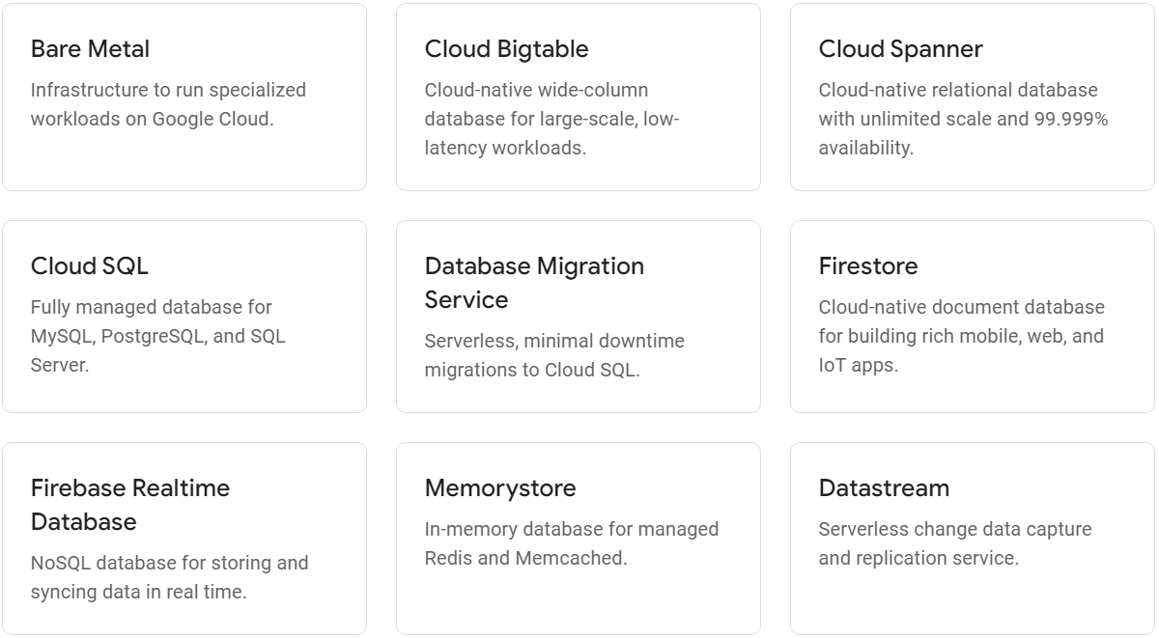
Databases

Slide 78
Cloud Bigtable
A fully managed, scalable NoSQL database service for large analytical and operational workloads with up to 99.999% availability.
Consistent sub-10ms latency—handle millions of requests per second
Ideal for use cases such as personalization, ad tech, fintech, digital media, and IoT
Seamlessly scale to match your storage needs; no downtime during reconfiguration
Designed with a storage engine for machine learning applications leading to better predictions
Easily connect to Google Cloud services such as BigQuery or the Apache ecosystem

Slide 79
Cloud Spanner
Fully managed relational database with unlimited scale, strong consistency, and up to 99.999% availability.
Get all the benefits of relational semantics and SQL with unlimited scale
Start at any size and scale with no limits as your needs grow
Enjoy high availability with zero scheduled downtime and online schema changes
Deliver high-performance transactions with strong consistency across regions and continents
Focus on innovation, eliminating manual tasks with capabilities like automatic sharding

Slide 80
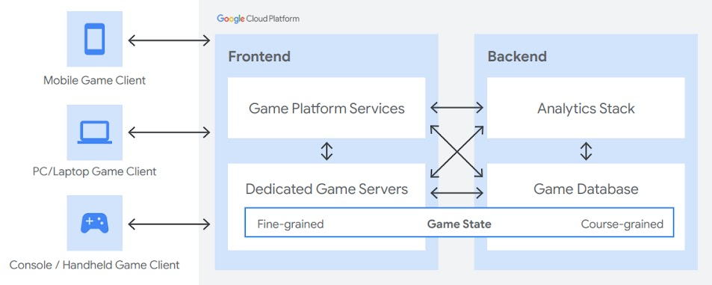
Example
Pricing for Spanner is simple and predictable. You are only charged for the compute capacity of your instance (as measured in number of nodes or processing units), the amount of storage that your database's tables and secondary indexes use (not pre-provisioned), backup storage, and the amount of network egress. Note that there is no additional charge for replication of data between zones or regions in an instance.

Slide 81
Cloud SQL
Fully managed relational database service for MySQL, PostgreSQL, and SQL Server. Run the same relational databases you know with their rich extension collections, configuration flags and developer ecosystem, but without the hassle of self management.
Reduce maintenance cost with fully managed MySQL, PostgreSQL and SQL Server databases
Ensure business continuity with reliable and secure services backed by 24/7 SRE team
Automate database provisioning, storage capacity management, and other time-consuming tasks
Database observability made easy for developers with Cloud SQL Insights
Easy integration with existing apps and Google Cloud services like GKE and BigQuery

Slide 82
Firestore
Easily develop rich applications using a fully managed, scalable, and serverless document database.
Serverless document database that effortlessly scales to meet any demand, with no maintenance
Accelerate development of mobile, web, and IoT apps with direct connectivity to the database
Built-in live synchronization and offline mode makes it easy to develop real-time applications
Fully customizable security and data validation rules to ensure the data is always protected
Seamless integration with Firebase and Google Cloud services like Cloud Functions and BigQuery

Slide 83
Pricing
FEATURE | PRICE
Stored data | $0.18/GB
Bandwidth | Google Cloud pricing
Document writes | $0.18/100K
Document reads | $0.06/100K
Document deletes | $0.02/100K

Slide 84
Firebase Realtime Database
Store and sync data in real time
The Firebase Realtime Database is a cloud-hosted NoSQL database that lets you store and sync data between your users in realtime.
Realtime syncing makes it easy for your users to access their data from any device: web or mobile, and it helps your users collaborate with one another.
Realtime Database ships with mobile and web SDKs so you can build apps without the need of servers. You can also execute backend code that responds to events triggered by your database using Cloud Functions for Firebase.
When your users go offline, the Realtime Database SDKs use local cache on the device to serve and store changes. When the device comes online, the local data is automatically synchronized.

Slide 85
Memorystore
Reduce latency with scalable, secure, and highly available in-memory service for Redis and Memcached.
Build application caches that provide sub-millisecond data access
100% compatible with open source Redis and Memcached
Migrate your caching layer to cloud with zero code change

Slide 86
Datastream
Serverless and easy-to-use change data capture and replication service.
Access to streaming, low-latency data from Oracle and MySQL databases
Powers real-time analytics, heterogeneous database synchronization & event-driven architectures
Serverless platform that automatically scales, with no resources to provision or manage
Easy-to-use setup with built-in secure connectivity for faster time to value
Datastream reads and delivers every change—insert, update, and delete—from your Oracle and MySQL databases to load data into BigQuery, Cloud SQL, Cloud Storage, and Cloud Spanner.

